Slide 1
Digital Thinking and Innovation CT109-3-1 VD1
Digital Ethics

Slide 2
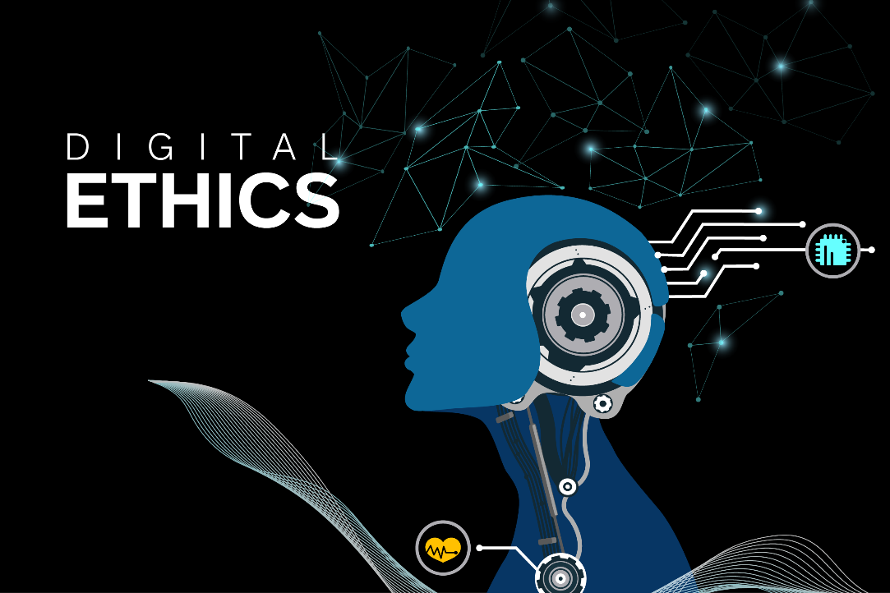
Introduction
This topic introduces digital ethics and its importance to act according to a code of ethics

Slide 3

Learning Outcomes of the Lecture
At the end of this section you will be able to:
Understand ethics and why is it important to act
according to a code of ethics
Know why business ethics is becoming increasingly important
Learn approaches that can be taken to ensure ethical decision making
Provide examples of ethical issues

Slide 4

Content
Computer Ethics, Ethics, Morals, Law
Code of Ethics and Professionalism
Importance of CSR
Bribes and Gifts

Slide 5

Key Terms
Computer Ethics, Ethics, Morals, Law
Code of Ethics, Professionalism

Slide 6
Mind Map
Digital Ethics
Computer Ethics, Ethics, Morals, Law
Importance of CSR
Bribes and Gifts
Code of Ethics and Professionalism

Slide 7
Learning Outcomes of the Lecture
At the end of this section you will be able to:
Understand ethics and why is it important to act
according to a code of ethics
Know why business ethics is becoming increasingly important
Learn approaches that can be taken to ensure ethical decision making
Provide examples of ethical issues

Slide 8
Ethics
Set of beliefs about right and wrong behavior within a society. Moral beliefs about right and wrong.
Morality: Shared social conventions about right and wrong that is the basis for an established consensus
Computer Ethics: Moral guidelines that govern the use of computer and Information Systems
Virtues and vices define an individual’s moral values
Virtue: Habit that inclines people to do what is acceptable
Vice: Habit of unacceptable behavior
8

Slide 9
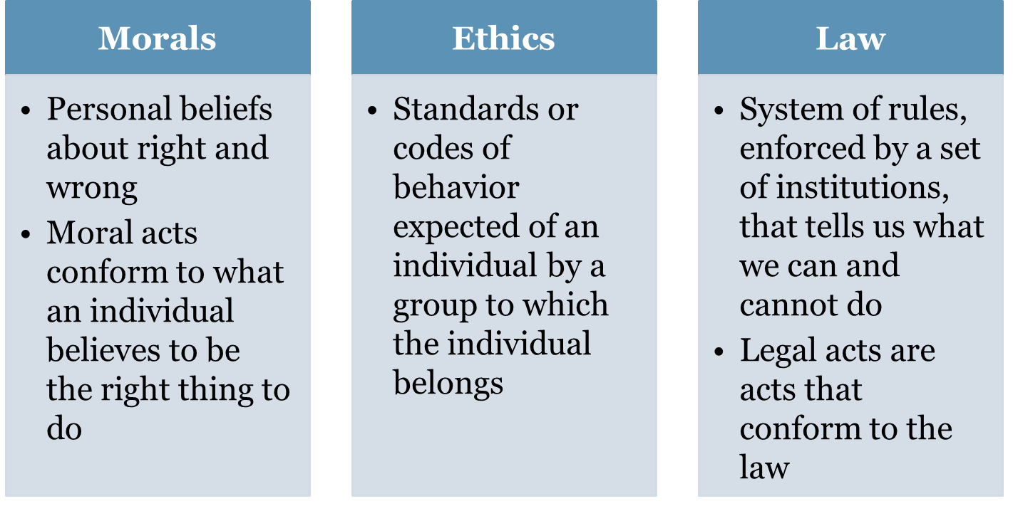
Moral, Ethics and Law

Slide 10
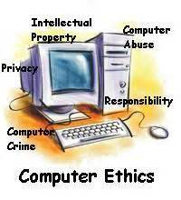
Computer Ethics
Concerns about the Ethical use of IT
E-mail and Internet access monitoring at work
Software piracy, downloading in violation of copyright laws
Unsolicited e-mail, spoofing,
spamming, phishing
Hacker and cracker theft
Plagiarism by students
Malware, cookies and
spyware to illegally track
a user
10
10

Slide 11
Code of Ethics
Organizations have Code of Ethics for its employees
Breaking the code of ethics can result in termination
It documents the
mission and values of the organization
how professionals are supposed to approach problems
the ethical principles based on the organization's core values
A code of ethics is important because it clearly lays the "rules" for behavior and provides a preemptive warning

Slide 12

Code of Ethics
Association for Computing Machinery (ACM)
Some examples
Avoid harm to others
Be fair and take action not to discriminate.
Honor property rights
Give proper credit for intellectual property
Respect the privacy of others
Honor confidentiality

Slide 13
Learning Outcomes of the Lecture
At the end of this section you will be able to:
Understand ethics and why is it important to act
according to a code of ethics
Know why business ethics is becoming increasingly important
Learn approaches that can be taken to ensure ethical decision making
Provide examples of ethical issues

Slide 14
Professionalism
Profession
Requires specialized knowledge and intensive academic preparation
Professionals
Possess advanced training and experience
Exercise discretion and judgment in their work
Keep abreast of developments in their field
Integrity
Acting in accordance with personal code of principles
Extending respect, consideration, moral values to all

Slide 15

Ethics in the Business World
Likelihood of Unethical Behavior
Complex work environments make it difficult to apply principles and codes of ethics consistently
Pressure to maintain revenue and profits
Risk of financial loss, criminal or civil lawsuits more prevalent for businesses that act unethically
Solution through Corporate Social
Responsibility (CSR)
Organization takes responsibility for the
impact of its actions on the environment,
community and employee welfare

Slide 16
Learning Outcomes of the Lecture
At the end of this section you will be able to:
Understand ethics and why is it important to act
according to a code of ethics
Know why business ethics is becoming increasingly important
Learn approaches that can be taken to ensure ethical decision making
Provide examples of ethical issues

Slide 17
Ethics Training
Educate employees how to apply code of
ethics in real life to encourage ethical behavior
Goal
Encourage employees to report any misconducts
Show employees effective ways of reporting incidents
Reassure employees that such feedback will be acted on and that they will not be subjected to retaliation
17

Slide 18
Ethical Decisions
To deal with computer crime, a firm should
Pursue prosecution of criminals at all costs
Maintain low profile to avoid negative publicity
Inform affected customers
Decisions to be taken by a firm
How much resources needed to safeguard against computer crime
What actions should be taken when
a software is found susceptible to hacking
recommended computer security safeguards increase operating costs
18

Slide 19
Learning Outcomes of the Lecture
At the end of this section you will be able to:
Understand ethics and why is it important to act
according to a code of ethics
Know why business ethics is becoming increasingly important
Learn approaches that can be taken to ensure ethical decision making
Provide examples of ethical issues

Slide 20
Ethical Issues
Software piracy
Business Software Alliance (BSA) - trade group that represents world’s largest software and hardware manufacturers
Aims to stop the unauthorized copying of software
Trade secret
Information that is of economic value and has effort or cost to develop with some degree of uniqueness or novelty
Whistle-blowing
Effort by an employee to attract attention to a negligent, illegal, unethical, or abusive act by a company that threatens the public interest
20
20

Slide 21
Ethical Issues
Conflict of interest
Conflict between employee’s self-interest and the interests of the client
Fraud
Obtaining goods, services, or property through deception or trickery
Misrepresentation
Misstatement or incomplete statement of a material fact
Breach of contract
When one party fails to meet the terms of a contract

Slide 22
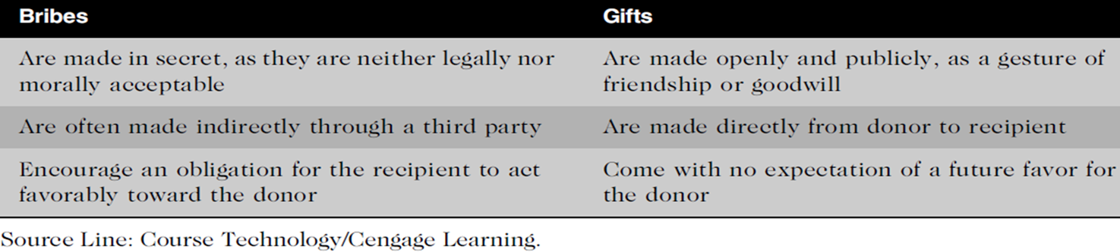

Bribes and Gifts

Slide 23
Summary
Understand ethics and why is it important to act
according to a code of ethics
Why business ethics is becoming increasingly important
Approaches that can be taken to ensure ethical decision making

Slide 24
Review Questions
Explain Ethics
Why is it important to act according to a code of ethics
How do you differentiate a Bribe from a Gift

Slide 25
Questions and Answer
Q & A

Slide 26
Next Lecture
Summary

